Slide 1


UNIT 7:
On top of the world
Croatia’s precious

Slide 2
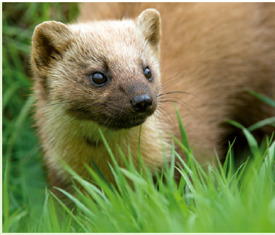
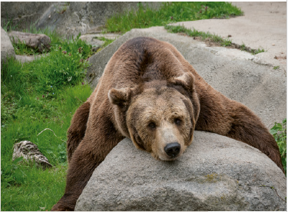
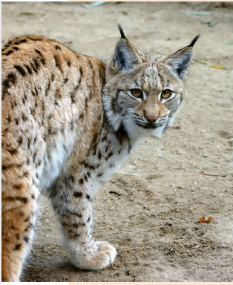
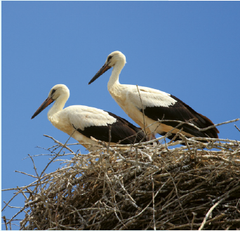
Name the animals.
How much do you know about them?
What do they have in common?

Slide 3
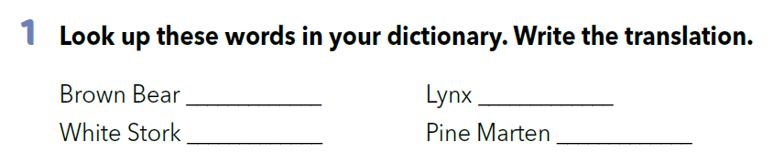
smeđi medvjed
ris
bijela roda
kuna zlatica

Slide 4
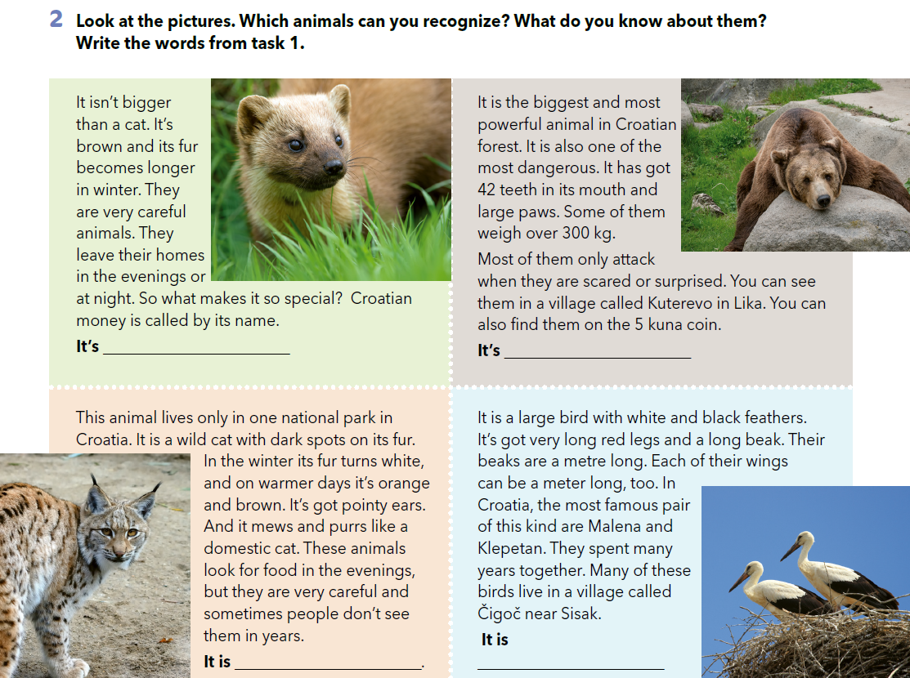
Pine Marten
Brown Bear
Lynx
White Stork

Slide 5
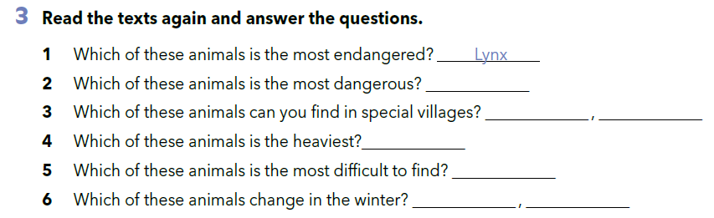
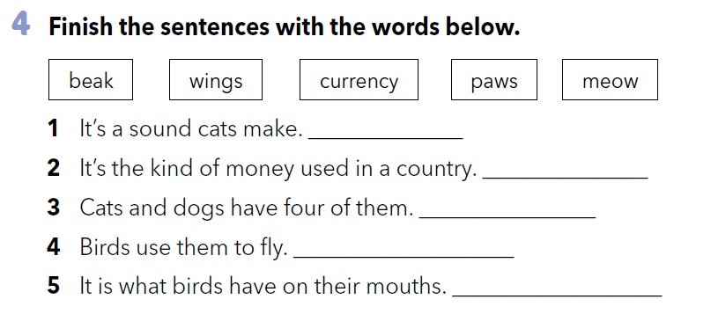
Brown Bear
White Stork
Brown Bear
Brown Bear
Lynx
Lynx
Pine Marten
What do these words mean?
Što ove riječi znače?
meow
currency
kljun
krila
valuta
šape
mjaukati
paws
wings
beak

Slide 6
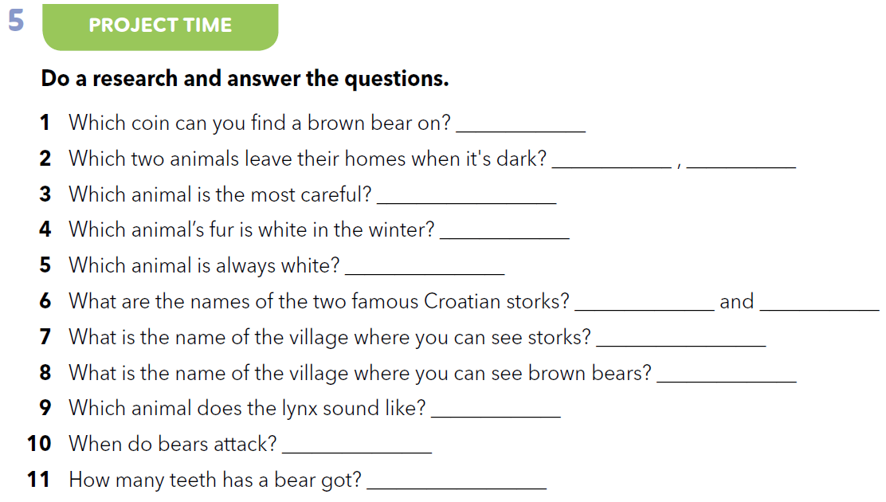

Slide 7
Write three new things that you learnt in the previous lesson and two things you would like to know more about in your notebook.
Read your answers. Your teacher writes down the things you would like to know more about.
Work in groups. Use the Internet and find the answers to your classmates’ questions.

Slide 8
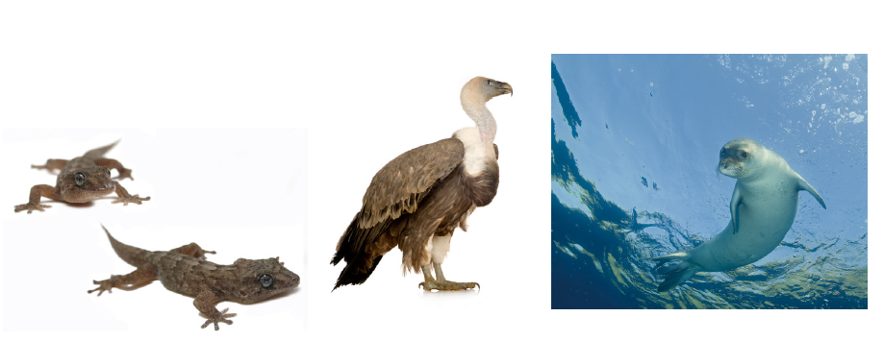
Look at the photos of animals in your book (p. 122, task 6).
Do you know any of these animals?
Have you ever seen them?
What do you know about them?

Slide 9
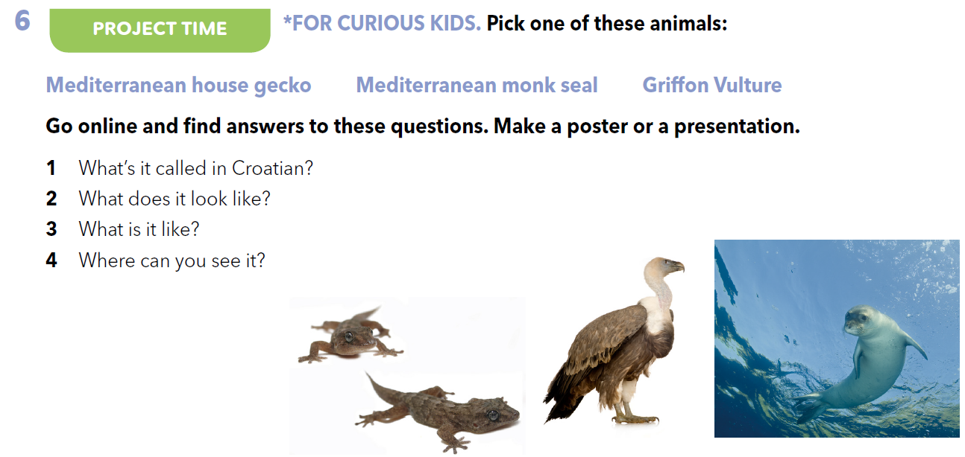
Work in groups. Go online and answer the questions about one of the animals in the pictures.
Add two pieces of information about your animal which you find interesting or important to mention.
Make a poster, mind map or a presentation.

Slide 10
Present your work to the class.
Listens to the presentations and write what was good and what could have been done better.
Write what each student from your group did well and what he/she could have done better.

Slide 11

LET’S REVISE!
https://www.bookwidgets.com/play/t:10aLtMUWVaZU0u9fegRCHFfz87S9rjyvC3JugOH+HM9ORVBXUzg=
SELF CHECK
https://www.e-sfera.hr/dodatni-digitalni-sadrzaji/62fc0467-3f41-4928-94c5-2f5a6e61e77e/

Slide 12
LEARN MORE.
https://www.e-sfera.hr/dodatni-digitalni-sadrzaji/62fc0467-3f41-4928-94c5-2f5a6e61e77e/
Plants of Croatia

